Slide 1

Biological Economics: Applied Mathematical Framework with ODTS
OBINexus Nnamdi
2025/10/25

Slide 2

Foundations
ODTS Framework
Scalar Models
Vector Models
Graph Models
Constitutional Integration

Slide 3

Implementation
Conclusion

Slide 4

01
Foundations

Slide 5

Biological Economics: The Living Mathematics
OBINexus Constitutional Framework
Introduction to Biological Economics
ODTS Verification
Biological economics integrates the principles of biology and economics to create sustainable systems. This approach ensures that economic activities support human survival and prosperity by adhering to biological imperatives.
The OBINexus framework provides a constitutional basis for biological economics, ensuring that economic systems are designed to support human dignity and survival through mathematically verified models.
The ODTS (OBINexus Derivative Tracing System) framework ensures the mathematical verification of economic flows, providing a robust method for detecting system limits and ensuring biological compliance.

Slide 6

Fundamental Survival Equation
The core biological imperative is represented by the equation work_income - essential_costs = survival_reserve. This equation ensures that income covers essential costs, maintaining a positive survival reserve.
Example Scenario
The Core Biological Imperative
For example, if an individual earns £15 and has essential costs of £10, the survival reserve is £5, indicating a healthy economic state aligned with biological needs.

Slide 7
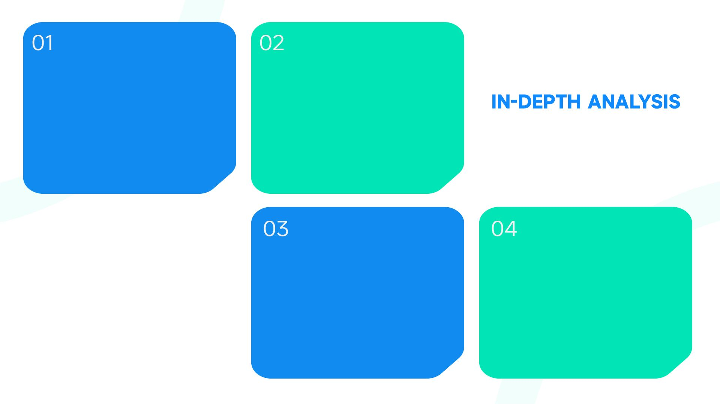
Biological First Principles
System Collapse
Organisms must consume energy to survive, and energy expenditure must not exceed energy acquisition. These principles form the basis of biological economics, ensuring sustainable economic systems.
Economic systems that violate biological principles are prone to collapse. By aligning economics with biology, we can prevent such failures and ensure long-term stability.
Human Economics
Sustainable Practices
Why Biology Precedes Economics
Human economics must adhere to biological reality. By recognizing this, we can design systems that support human well-being and avoid the pitfalls of extractive economics.
Implementing biological economics ensures that economic activities are sustainable and do not deplete resources, supporting both current and future generations.

Slide 8

The Current System Failure
Extractive Economics
Current economic systems often extract more resources than they provide, leading to negative survival reserves. For example, an income of £15 with costs of £20 results in a -£5 survival reserve, causing stress and potential collapse.

Slide 9

OBINexus Biological Economics Solution
Constitutional Guarantees
Mathematical Foundation
OBINexus proposes constitutional guarantees to ensure housing costs do not exceed the annual cost of hostel stays, maintaining a minimum survival reserve for all individuals.
The ODTS framework provides the mathematical foundation for verifying these guarantees, ensuring that economic systems remain aligned with biological imperatives and prevent constitutional violations.

Slide 10
02
ODTS Framework

Slide 11

Introducing ODTS Framework
The OBINexus Derivative Tracing System (ODTS) is a mathematical framework designed to verify economic flows. It ensures that economic activities are aligned with biological imperatives.
ODTS provides bounded computation with guaranteed termination, ensuring that calculations do not lead to infinite loops or undefined states, maintaining system stability.
ODTS generates cryptographic audit trails, providing transparent and verifiable records of all economic transactions and ensuring accountability and integrity.
ODTS optimizes economic paths to minimize costs, ensuring that resources are used efficiently and sustainably, supporting long-term economic health.
OBINexus Derivative Tracing System
Bounded Computation
Cryptographic Audit Trails
Minimal-Cost Path Optimization

Slide 12

ODTS Order Notation for Economics
D=1: Verifies income flows to ensure that income sources are sustainable and contribute positively to the survival reserve, maintaining economic health.
D=2: Analyzes cost structures to identify areas where costs can be optimized, ensuring that essential expenses do not deplete the survival reserve.
D=3: Assesses system stability by evaluating higher-order derivatives, ensuring that economic systems remain resilient and do not lead to collapse.
Income Flow Verification
Cost Structure Analysis
System Stability Assessment

Slide 13

Economic Function
The economic function f(work, housing) = survival_reserve is analyzed using ODTS notation to ensure that income and costs are balanced, maintaining a positive survival reserve.
My Example in ODTS Notation
Derivative Calculations
D=1 calculations show that income increases survival while housing costs decrease it. These derivatives help in understanding the impact of each factor on the survival reserve.

Slide 14
03
Scalar Models

Slide 15
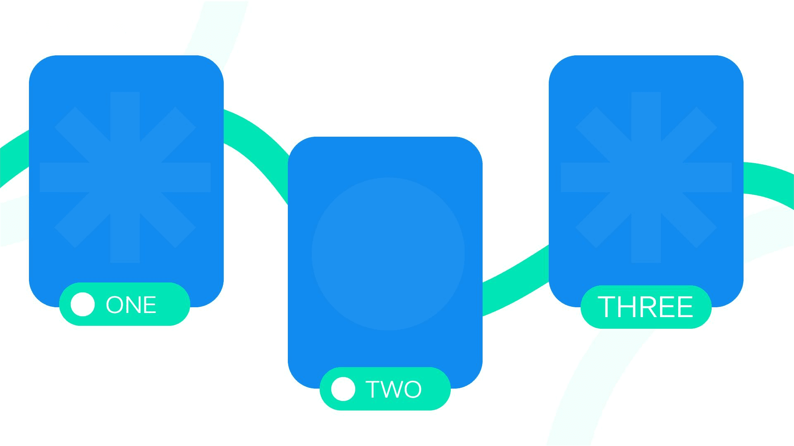
Biological Economics as Scalars
Single Household Model
Mathematical Verification
The BiologicalEconomy class models a single household with work_income=15, housing_cost=10, food_energy=3, and essentials=2. The survival_check() method ensures a non-negative survival reserve.
ODTS verifies that the household model adheres to biological imperatives, ensuring that economic activities support survival and prosperity.
Survival Imperative
The survival imperative is maintained by ensuring that the survival reserve is non-negative. This model serves as the foundation for more complex economic systems.

Slide 16

Scalability Proof
Scalability from Scalar to Tensor
The model scales from individual (scalar) to household (vector), community (matrix), and biome (tensor). ODTS ensures that each transformation maintains biological integrity and economic stability.

Slide 17
04
Vector Models

Slide 18
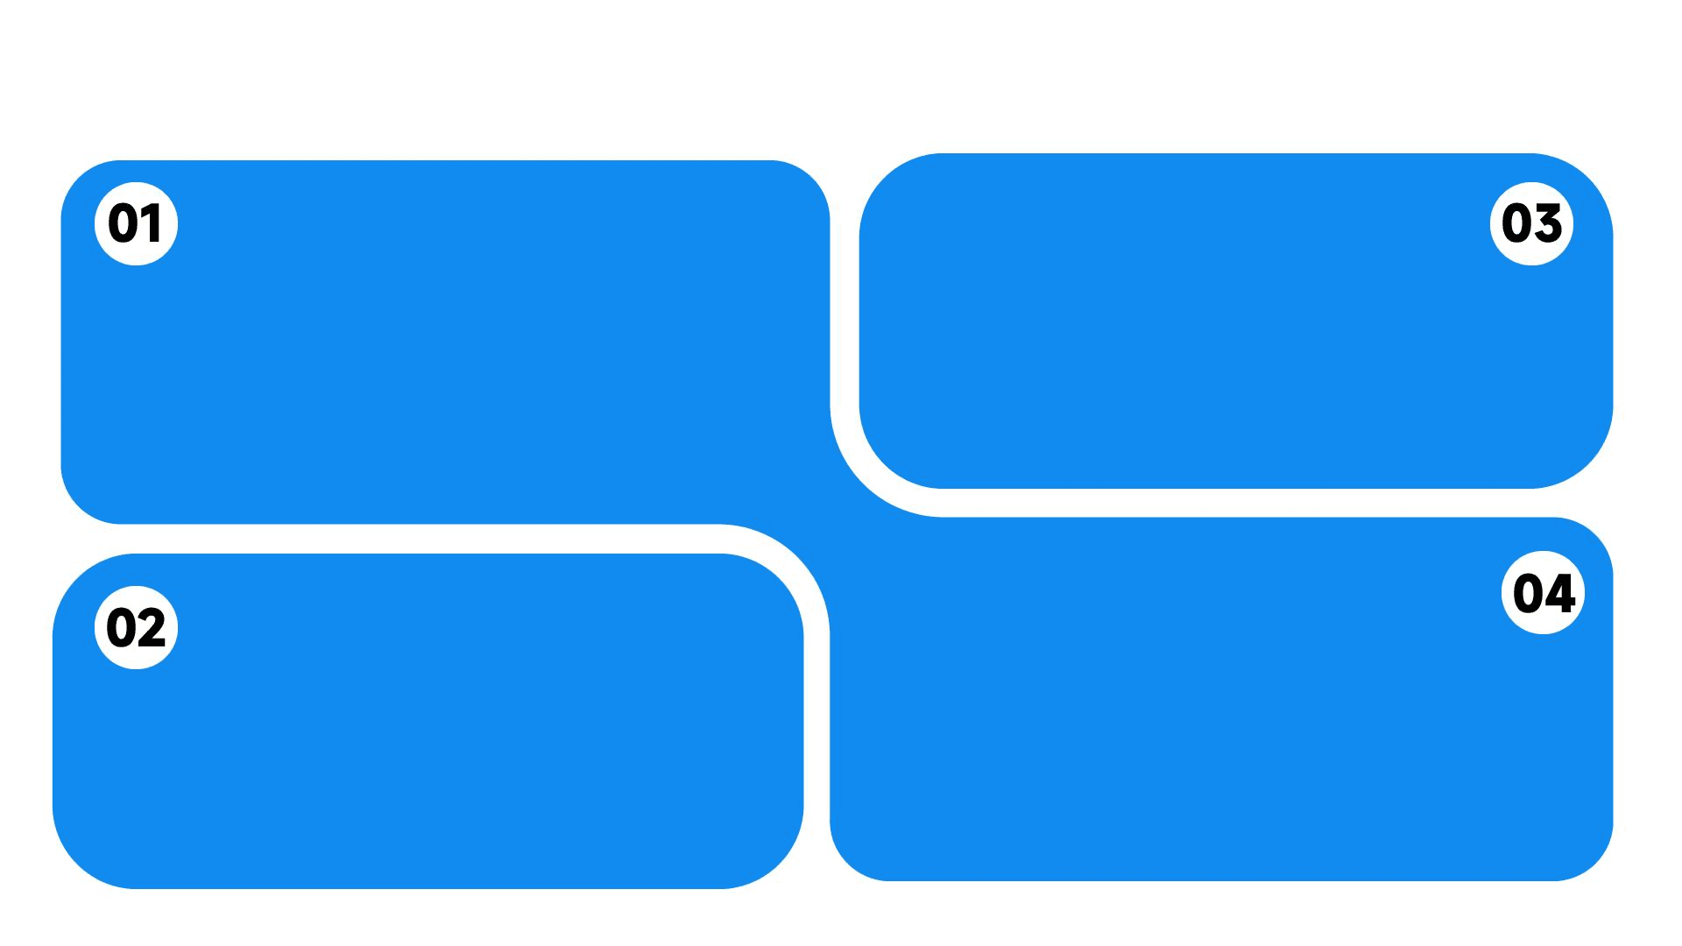
Vector Model - Household Level
Household Economic Vector
Shared Housing Costs
The household economic vector includes multiple earners with income=[15,12,8], shared housing=10, individual food=[3,2,1], and surplus=[2,0,-3]. This model detects biological stress points.
Shared housing costs reduce individual burdens, ensuring that housing remains affordable and does not deplete the survival reserve.
Surplus Detection
Income Distribution
Income is distributed among multiple earners, ensuring that the total income supports the household's survival reserve and maintains economic stability.
The surplus component detects households under stress, allowing for interventions to maintain biological and economic health.

Slide 19

Community Economic Matrix
Economic Rebalancing
The community economic matrix includes multiple households with varying income, housing, food, and essentials values. This model enables ODTS analysis to detect system stress points.
ODTS analysis helps in rebalancing economic flows, ensuring that all households maintain a positive survival reserve and contribute to community prosperity.
Matrix Model - Community Level

Slide 20

Tensor Model - Biome Level
Biome Economic Tensor
Resource Sharing
Long-Term Tracking
The biome economic tensor spans multiple communities, integrating cross-community resource sharing, educational integration, and long-term progression tracking.
Cross-community resource sharing ensures that resources are distributed efficiently, supporting the survival and prosperity of all community members.
Long-term progression tracking ensures that the biome remains aligned with biological imperatives, maintaining economic stability and supporting sustainable development.

Slide 21
05
Graph Models

Slide 22

The Housing Price Anchor
Biological Pricing Model
ODTS Compliance
The biological pricing model ensures that housing costs do not exceed the annual cost of hostel stays, preventing extractive pricing and maintaining economic stability.
ODTS verifies compliance with the biological pricing model, ensuring that housing remains affordable and supports the survival reserve of all community members.

Slide 23

Directed Acyclic Graph Modeling
Economic Flows as DAG
Acyclic Properties
Mathematical Verifiability
Economic flows are modeled as a Directed Acyclic Graph (DAG), ensuring that there are no debt traps or circular dependencies, maintaining clear economic causality.
The acyclic properties of the DAG prevent debt traps, ensuring that economic activities lead to sustainable outcomes and do not result in system collapse.
Each edge in the DAG is mathematically verified, ensuring that economic transactions are transparent and maintain biological and economic integrity.

Slide 24

Economical DAG Class
The EconomicDAG class models economic flows with nodes representing income, housing, food, essentials, and surplus. The verify_biological_integrity() method ensures a non-negative survival reserve.
DAG Implementation Example

Slide 25
06
Constitutional Integration

Slide 26

Iwu Constitutional Integration
Traditional Igbo Governance
ODTS Verification Layer
The Iwu system of traditional Igbo governance provides community laws and protocols that ensure economic activities support community well-being and biological imperatives.
The ODTS verification layer ensures that all economic activities are mathematically verified, maintaining biological and economic integrity across the community.
Oha Public Assembly
Culturally Grounded Economics
Oha public assembly enables community decision-making, ensuring that economic policies are aligned with community needs and biological requirements.
By integrating traditional governance with modern verification, we create culturally grounded economic systems that support community prosperity and biological health.

Slide 27

Bioeconomic Councils
Ring-Zone Implementation
Bioeconomic councils implement ring-zone structures with 2.5-mile radius self-sustaining units, enabling local economic governance and cross-zone resource sharing.
ODTS Verification
ODTS verifies inter-zone flows, ensuring that resource sharing maintains biological integrity and supports the survival and prosperity of all community members.

Slide 28
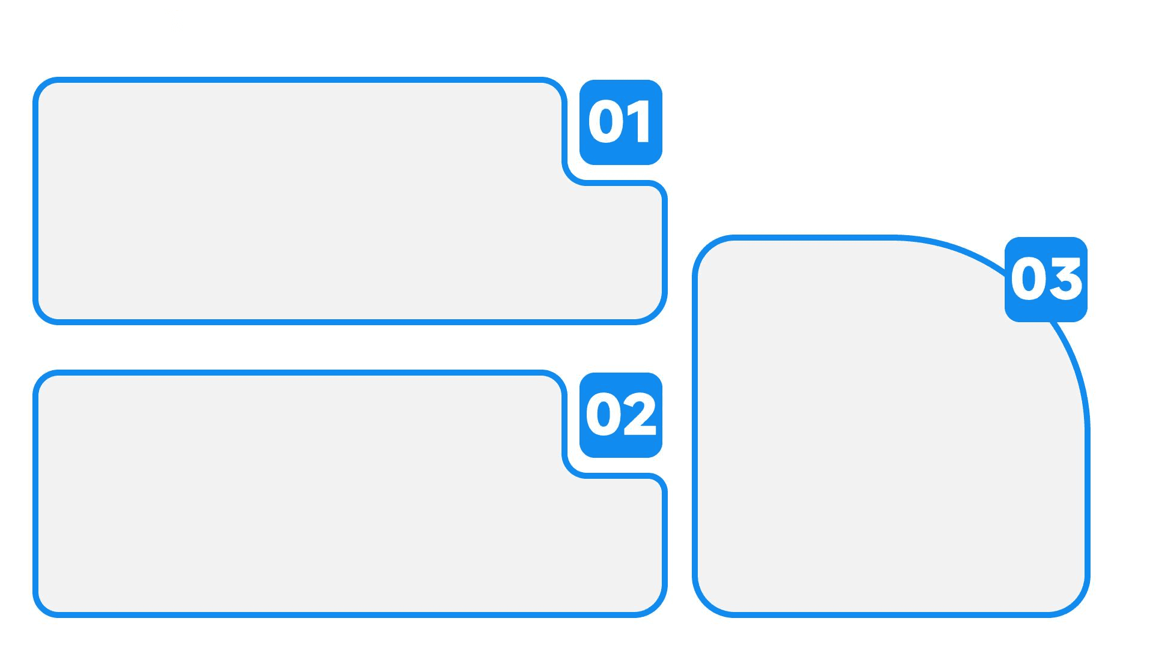
Educational Integration DAG
10-Year Educational Progression
The 10-year educational progression from foundation to ownership is modeled as a DAG, ensuring that each stage increases economic resilience and biological prosperity.
ODTS Analysis
Economic Graph
ODTS analysis ensures that the educational progression supports long-term economic health, maintaining a positive survival reserve and supporting community prosperity.
The educational stages are represented as nodes in the economic graph, with directed edges showing the progression and impact on economic stability.

Slide 29
07
Implementation

Slide 30

Practical Example - Your Scenario
Initial State
The initial state with work_income=15, housing_cost=10, survival_reserve=5, and biological_status='HEALTHY' demonstrates ODTS verification of system coherence and biological compliance.

Slide 31
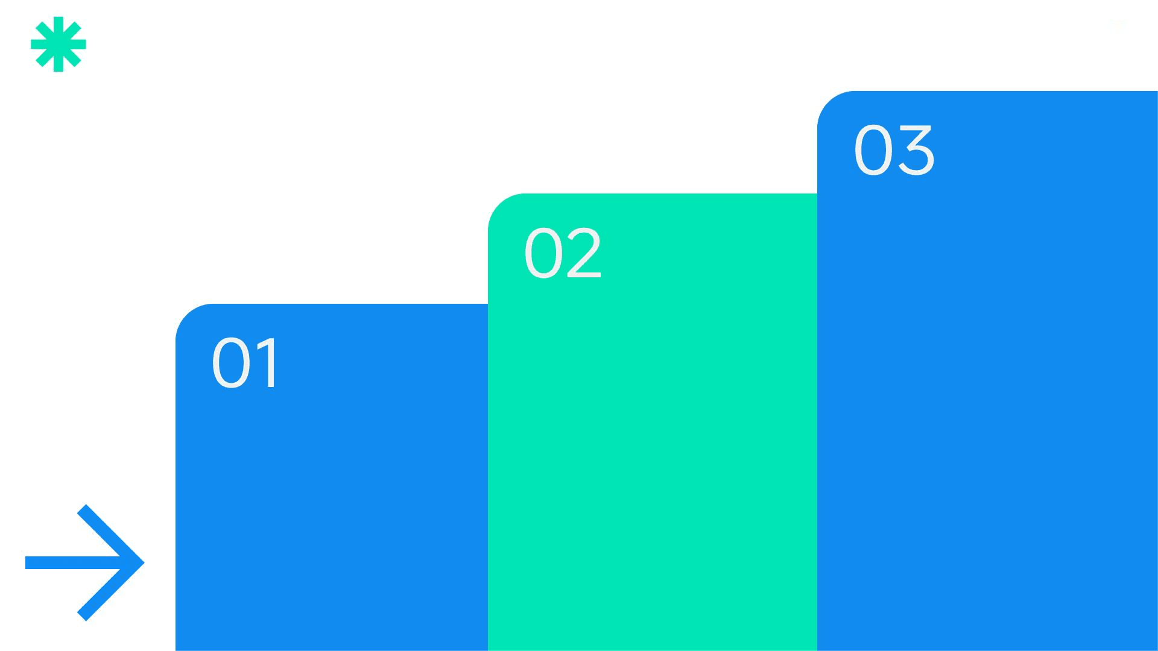
Stress Test Scenario
Emergency Response
Emergency protocols activate community support, reduce housing costs, and provide emergency work opportunities to restore a positive survival reserve.
ODTS Detection
ODTS detects the constitutional violation, triggering emergency protocols to restore biological compliance and prevent system collapse.
Economic Shock
An economic shock reduces work_income to 12 while housing_cost remains at 10, resulting in a negative survival_reserve of -3 and a biological_status of 'STRESSED'.

Slide 32

Biological Economic Protocols
Community support activation and temporary housing cost reduction are part of the emergency response protocols to restore biological compliance.
Emergency Response
ODTS Verification
ODTS verifies the recovery path, ensuring that emergency protocols restore a positive survival reserve and maintain biological and economic integrity.

Slide 33

Long-Term Stability
Biome Maturation Timeline
Year 1-3: Foundation
Year 3-6: Growth
Year 6-10: Maturity
The biome maturation timeline includes stages from foundation to regeneration, with each stage supporting long-term stability and prosperity.
The foundation stage focuses on hostel-cost housing, ensuring basic survival needs are met and economic activities are aligned with biological imperatives.
The growth stage accumulates equity, supporting community development and ensuring economic activities contribute to long-term prosperity.
The maturity stage achieves full ownership, ensuring community wealth and maintaining biological and economic integrity through ODTS tracking.

Slide 34
Mathematical Guarantees
Derivative Exhaustion Detection
Cross-Partial Consistency
ODTS detects derivative exhaustion, ensuring that economic systems do not lead to undefined states and maintain biological compliance.
ODTS ensures cross-partial consistency, verifying that all economic activities are aligned and support long-term biological and economic health.
Bounded Computation
Bounded computation ensures that calculations terminate, preventing infinite loops and maintaining system stability and biological integrity.

Slide 35

Implementation Roadmap
Phase 1: Individual Economic DAG
Phase 1 focuses on individual economic DAG modeling with ODTS prototype and single-household compliance, laying the foundation for community-scale implementation.

Slide 36
08
Conclusion

Slide 37

Cultural Mathematics
Igbo Wisdom
W→Z→Y→X Problem Resolution
Igbo wisdom provides cultural patterns and principles that support biological economics, ensuring that economic systems are grounded in traditional knowledge and mathematical verification.
The W→Z→Y→X problem resolution framework ensures that abstract challenges are transformed into concrete solutions, supporting biological and economic health.
7+7 Level Progression
Build Your Own Biome
The 7+7 level progression model ensures that economic activities are aligned with biological imperatives, supporting long-term stability and prosperity.
The constitutional principle 'When systems fail, build your own biome' encourages community resilience and self-sufficiency, ensuring biological and economic integrity.

Slide 38
Summary - The Biological Economic Revolution
Biology Precedes Economics
Survival Reserve
Culturally Grounded Implementation
The biological economic revolution prioritizes biological imperatives over economic activities, ensuring that economic systems support human survival and prosperity.
Maintaining a non-negative survival reserve is crucial for economic stability and biological health, ensuring long-term prosperity.
Implementing biological economics with cultural grounding ensures that economic systems are aligned with traditional knowledge and mathematical verification.

Slide 39
Call to Action
Join the Revolution
Build Systems for Life
Join the biological economic revolution by participating in the development and implementation of ODTS and biological economics through GitHub repositories.
Build systems where mathematics serves biology, economics serves community, and technology serves human dignity, ensuring long-term prosperity and biological health.

Slide 40

Foundational Resources
Key resources include the OBINexus Derivative Tracing System Framework, Biological Economics Constitutional Mandate, Igbo Iwu Governance Protocols, Directed Acyclic Graph Economic Modeling, and Ring-Zone Bioeconomic Implementation.
References & Resources

Slide 41

Live Demonstration
Live demonstrations include ODTS verification of economic scenarios, DAG modeling of household economics, emergency protocol simulation, and biome scaling mathematics, showcasing the commitment to mathematics in service of life.
Q&A

Slide 42

2025/10/28
OBINexus Nnamdi Michael Okpala-Founder

